Slide 1


Team 10: Smart Irrigation System
Team members: Matthew Eisen, Xavier Garza, Jack Hwang
Sponsor: Dr. John Lusher
TA: Eric Robles

Slide 2
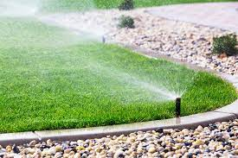
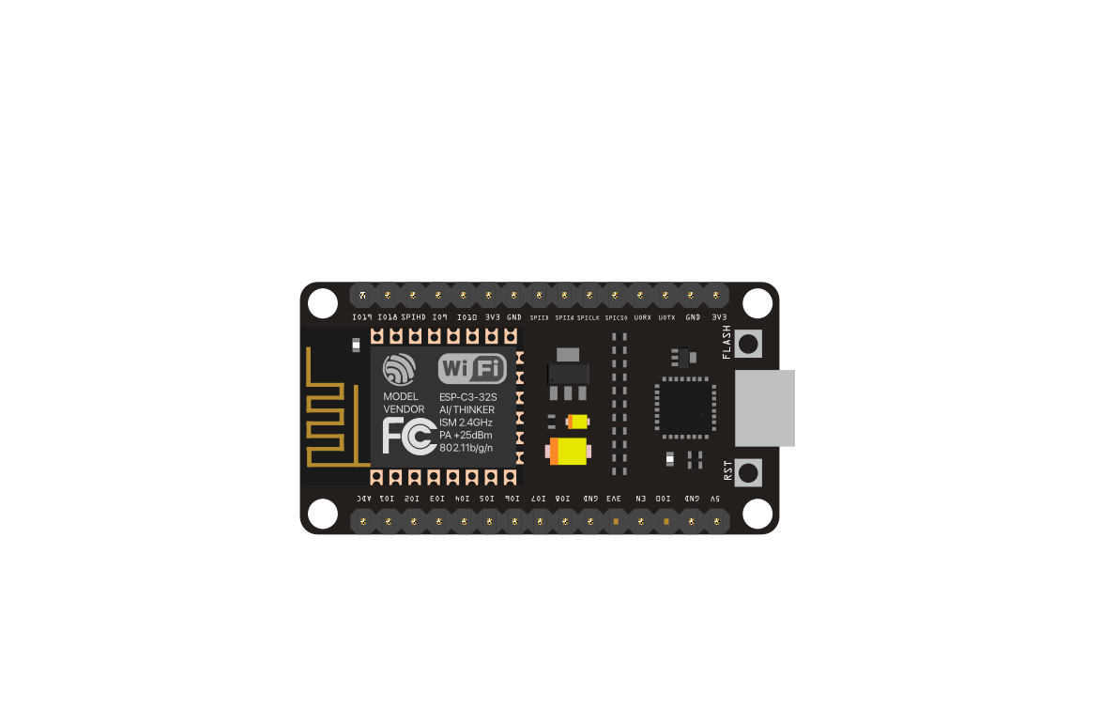


Executive Summary
Problem Statement:
The Smart Watering system will:
Traditional sprinkler systems often use too much water due to rain resulting in a higher water bill
They offer limited customization options, making it difficult to ensure that all areas of the yard receive the right amount of water
Read weather data and sensor data to provide an accurate amount of water needed
Allow the user to customize their system according to their soil type and shade amount
Preserve traditional functionality

Slide 3
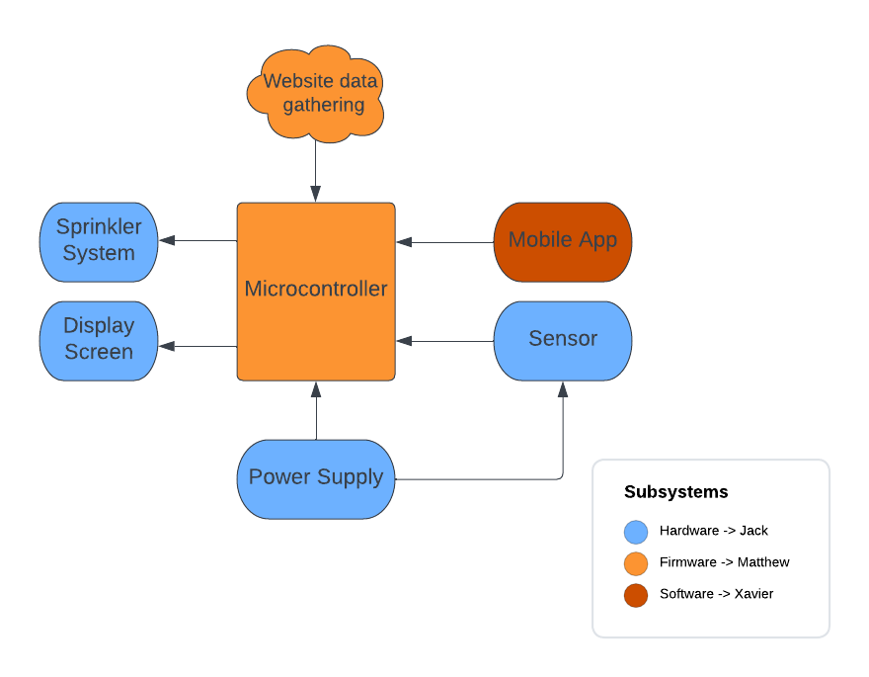
Subsystem Overview

Slide 4
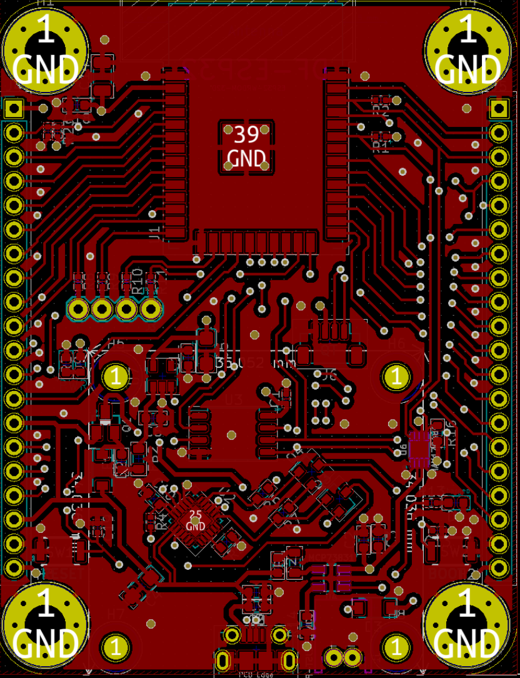
Hardware Subsystem
Accomplishments:
Simulated Power circuit
Breadboard tested
Completed PCB design for MCU, Power (need to finalize), and battery charger
Completed design for the battery charger

Slide 5
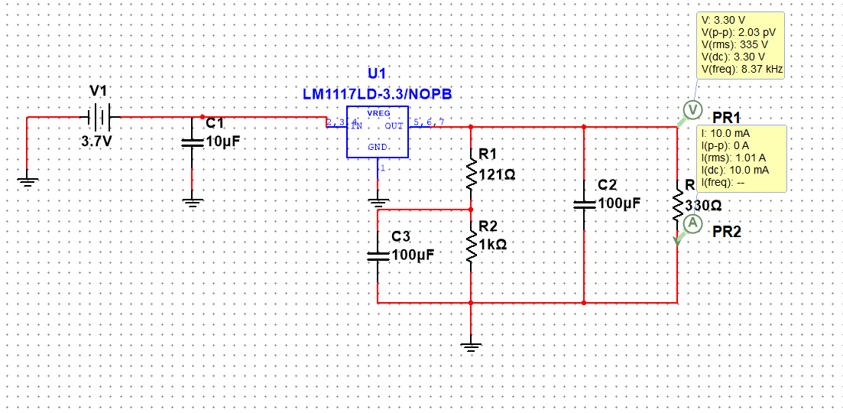
Hardware Subsystem
Simulation results:
Vin [V] | Load [mA] | Vout [V]
3.7 | 10 | 3.3
3.7 | 100 | 3.3
3.7 | 150 | 3.28
3.7 | 200 | 3.27

Slide 6
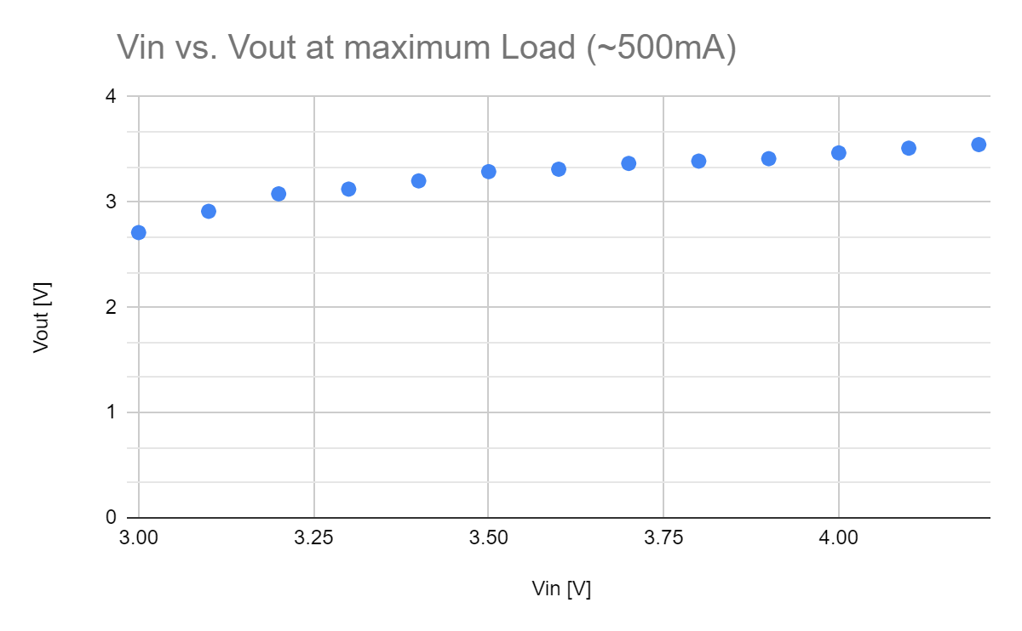
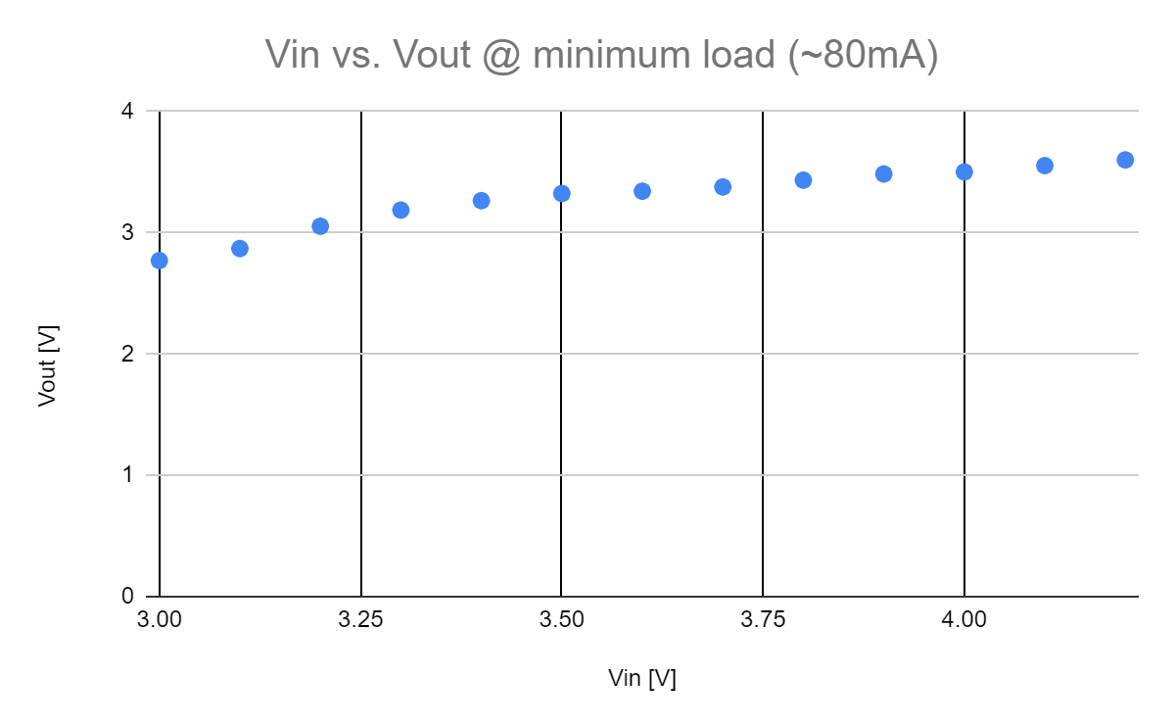
Hardware Subsystem
Breadboard testing:
Testing on various loads for Voltage regulator:
Vin [V] | Load [mA] | Vout [V]
3.7 | 194 | 3.512
3.7 | 165 | 3.498
3.7 | 132 | 3.401
3.7 | 82.5 | 3.354
3.7 | 66 | 3.343

Slide 7
Android App Subsystem
Accomplishments:
Takes in and displays user parameters
Soil type
Amount of shade
Time for simple mode deployment
Convert user parameters to integers for MCU
Displays weather data for current location
Ability disable undesired zones
Tested on real device

Slide 8
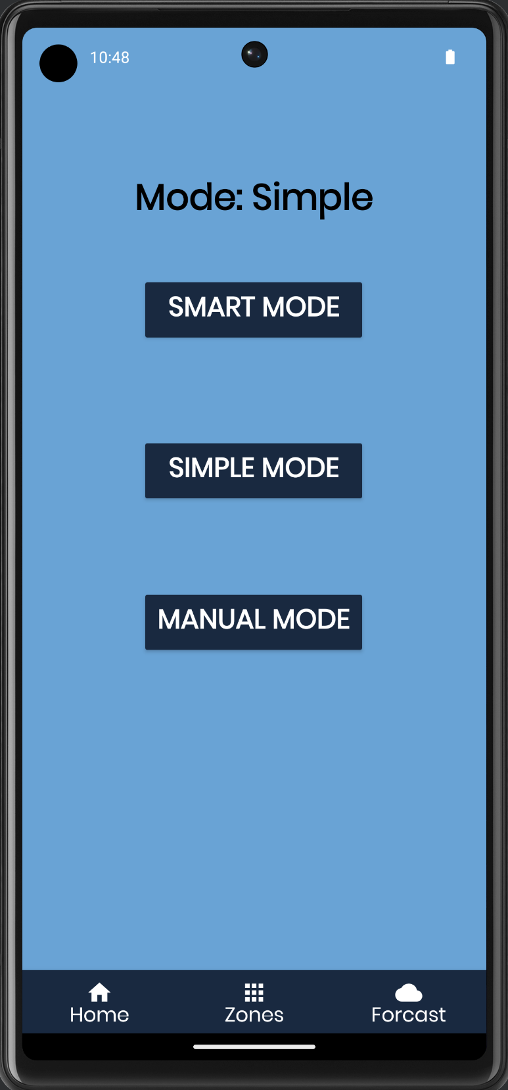
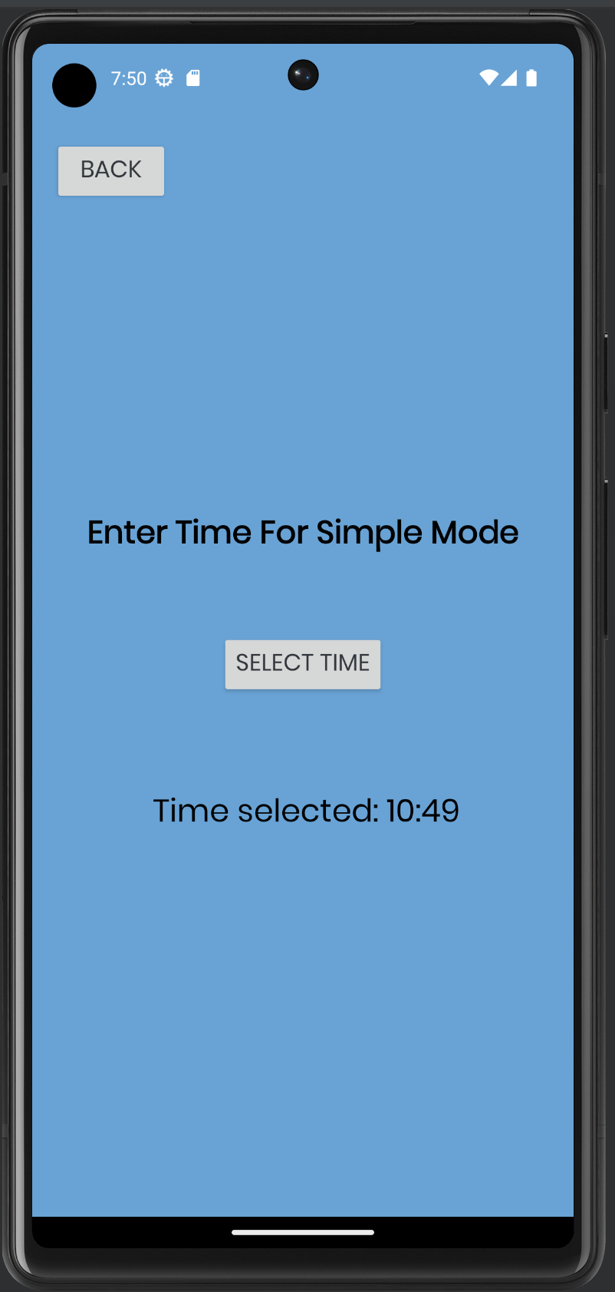
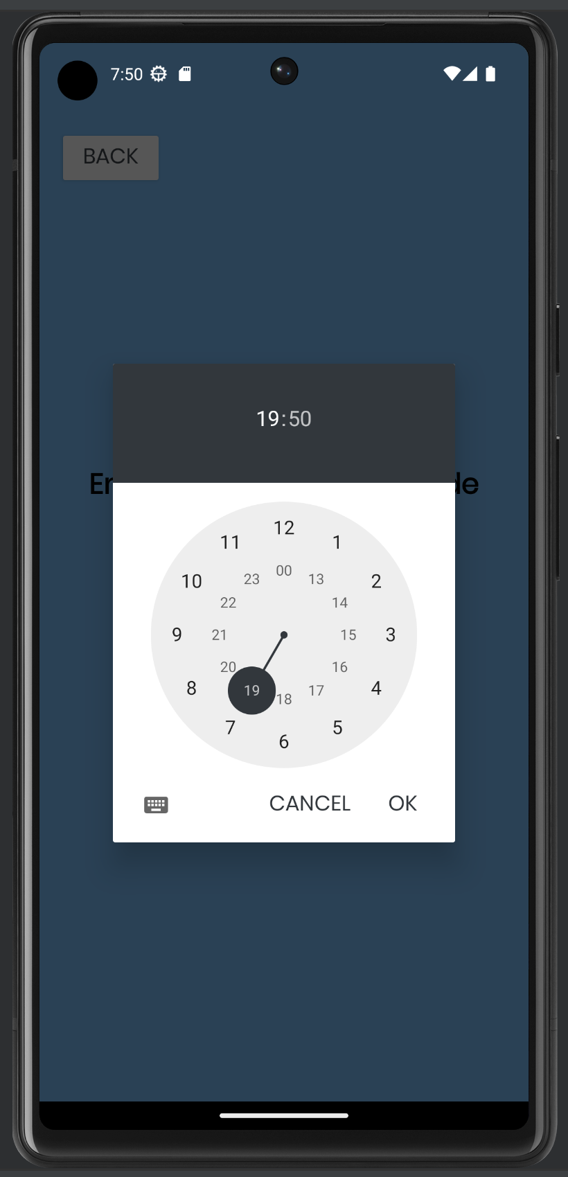
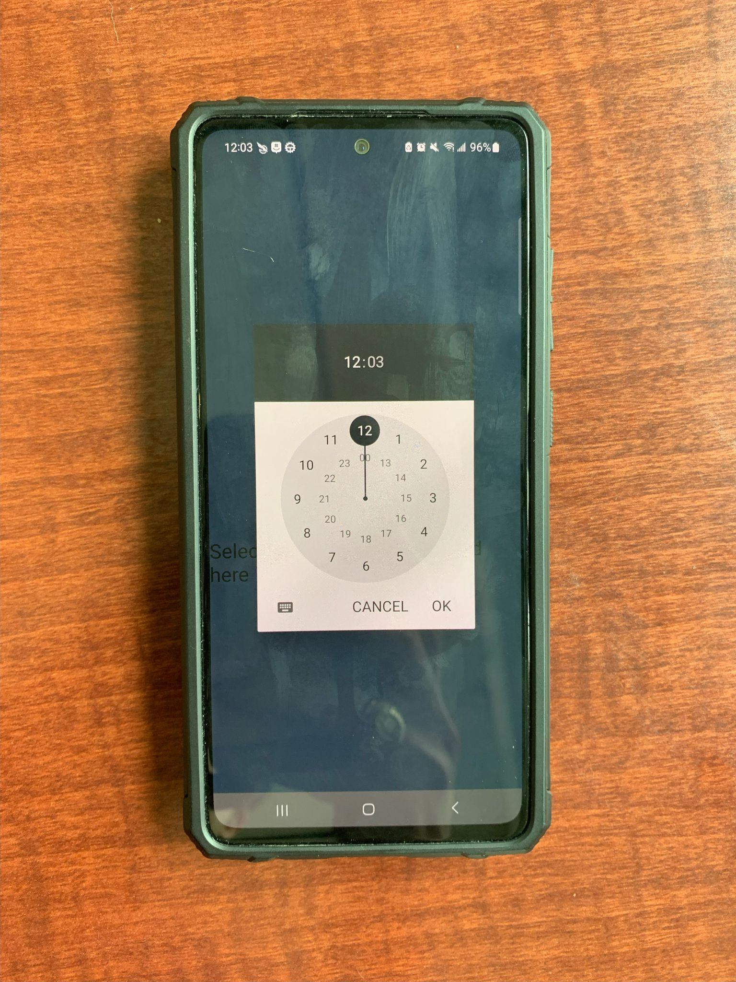
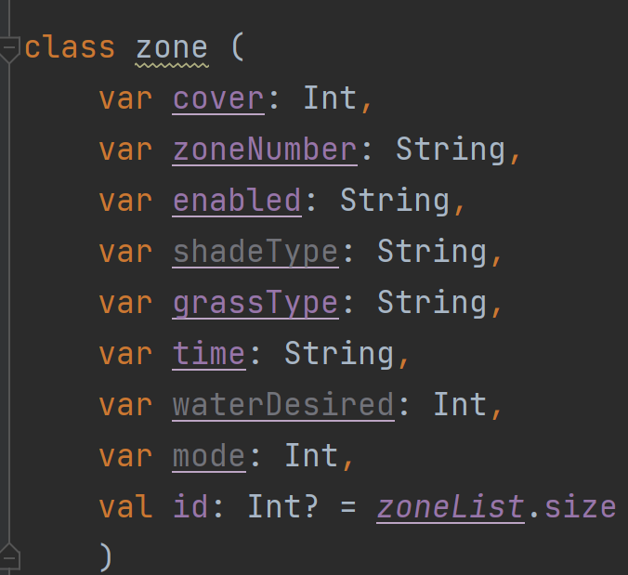
Android App Subsystem

Slide 9
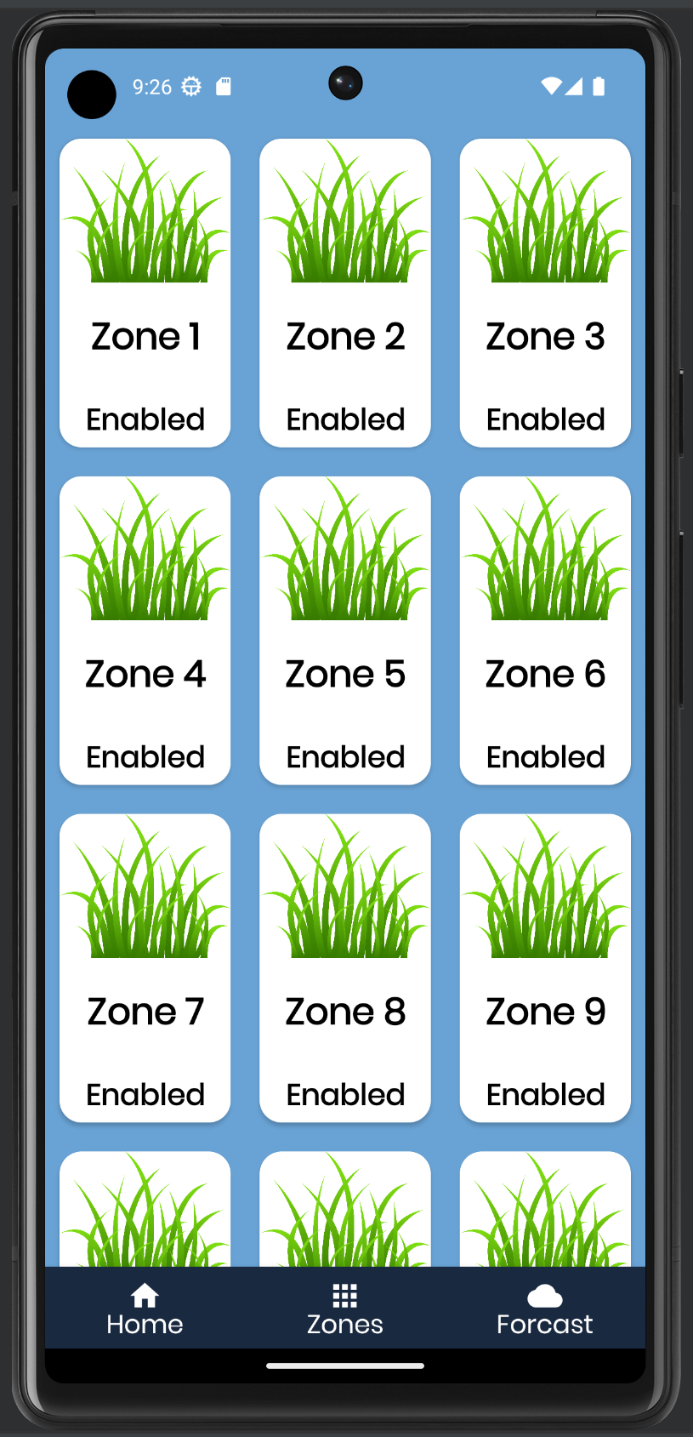
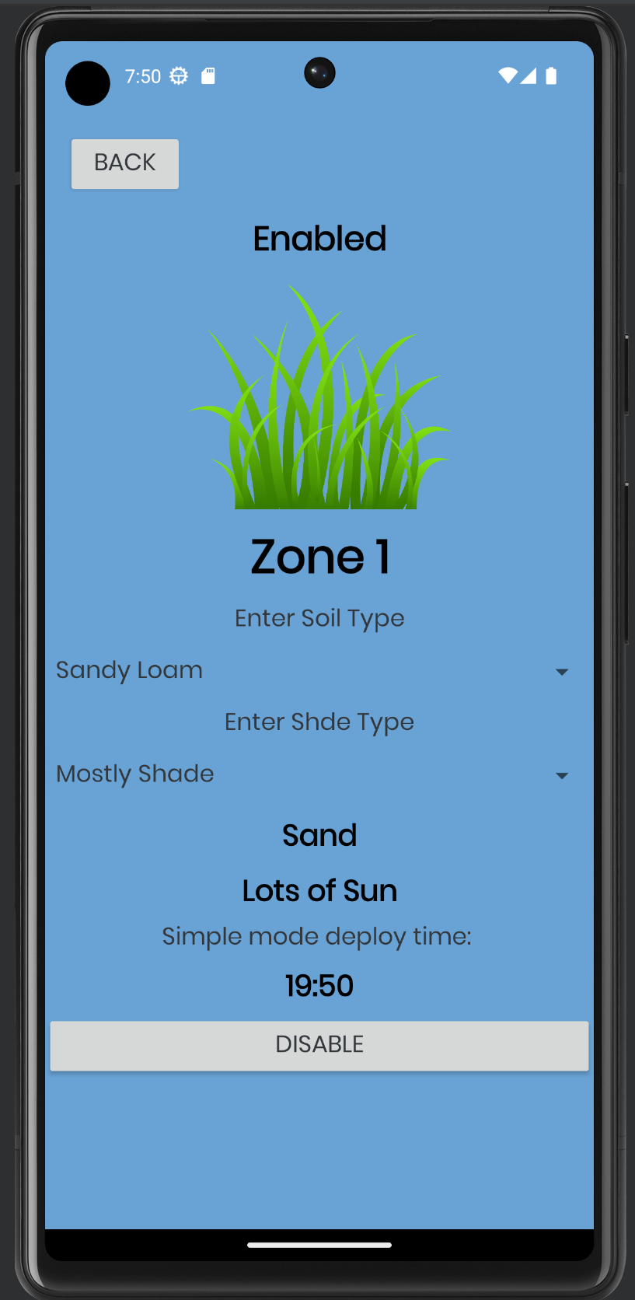
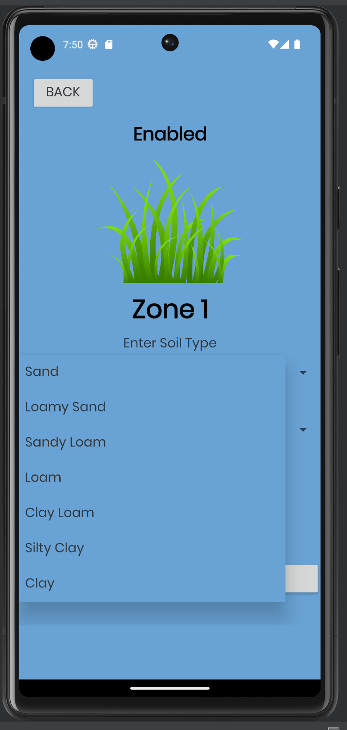
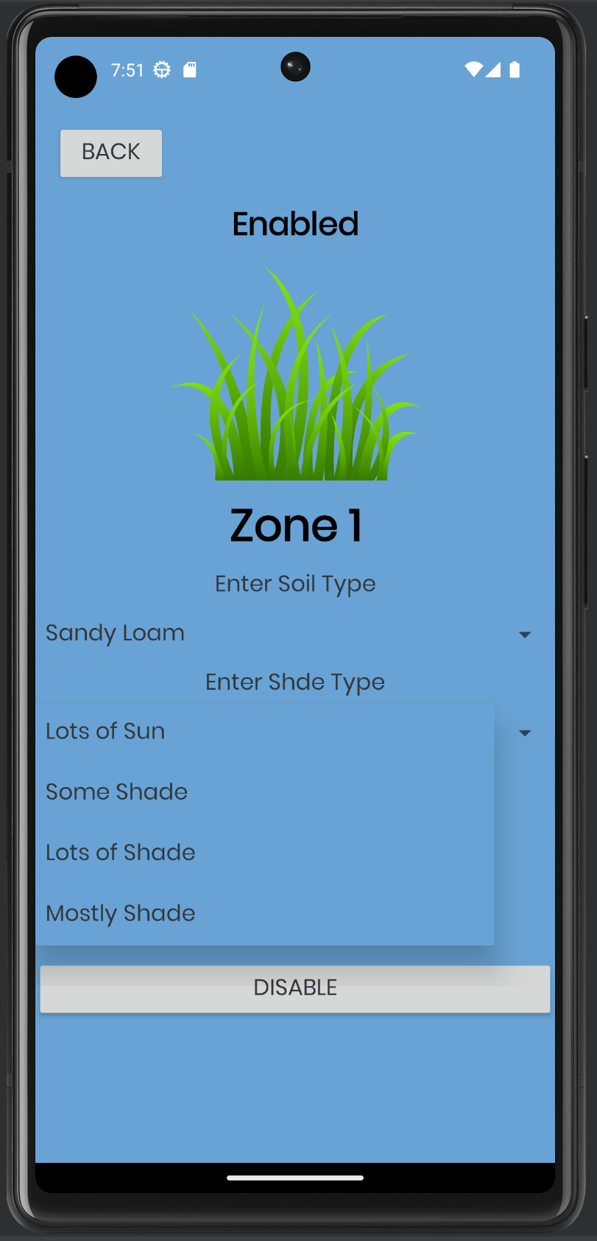
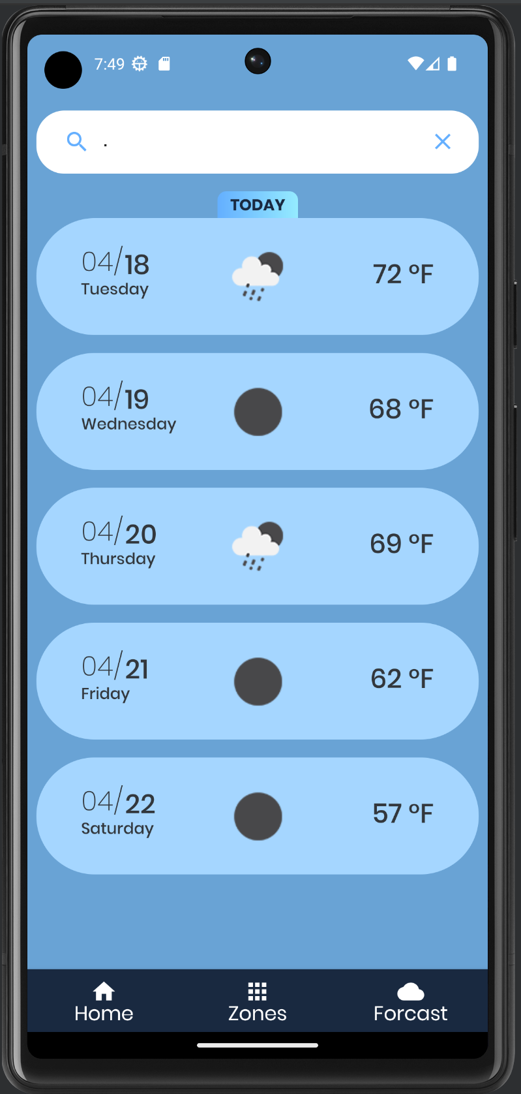
Android App Subsystem

Slide 10
Firmware Subsystem
Accomplishments:
Taking manual inputs from operator
Connecting to local WiFi networks to read local time and forecast data
Designing an internal clock to record time since last rainfall
Developing algorithm for “smart” mode (see next slide)

Slide 11
Firmware Subsystem (Algorithm)
x4
Days Since Last Rain
Inches of Rain in Soil
5 Day Forecast
x0.1
Weighted Days
Soil Saturation %
Day 1 Rain
Day 2 Rain
Day 3 Rain
Day 4 Rain
Day 5 Rain
x2
x4
x3
x2
x0.75
x5
Weighted Combination
x0.25
Weighted Forecast
x7
Data types:
Float
String
Bool
Float (0-1)
/2.2
Activate System
if >= 1
Normalized
Combination
Exception cases:
Soil Sat. % = 1
Weighted Forecast >= .7
Do Not Activate System
if < 1

Slide 12
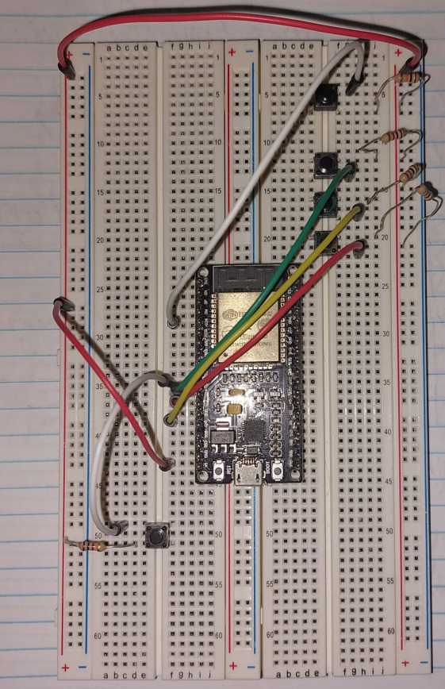
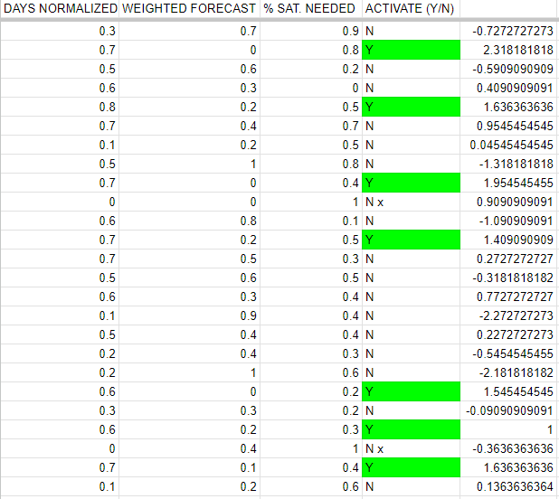
Firmware Subsystem

Slide 13
Execution and Validation Status
 | March 31st | April 7th | April 14th | April 21th
Android App | Create home, zones, and forcast pages and display weather data | Complete each mode on the home page. | Take in and display user parameters. | Convert string user parameters to integers for MCU. Test user parameter for edge cases
Hardware | Complete design of battery charger | Simulate Power Circuit and test it on breadboard | Complete PCB Design | Successfully solder components on perfboard and test
Firmware | Create test environment, initialize inputs and outputs, take user inputs | Complete unique operating modes, parse time and forecast data | Create automatically updating internal clock, implement and test rain gauge | Evaluate random test cases to finalize “smart” algorithm

Slide 14
Remaining Tasks
403:
Android app
Test edge cases for user inputs
More research on water amounts for different soil types
Hardware
Test power circuit through perf board
Test battery charge
Firmware
Debug system for fluidity
Connect and test rain gauge
Finalize “smart” mode timing

Slide 15
Remaining Tasks
404:
Android app
Create manual mode functionality for all zones
Improve GUI design
Send data over bluetooth to MCU
Hardware
Finalize PCB design
Improve power delivery to the MCU
Firmware
Receive data from the app
Get system specific details (number of heads, water flow rate, soil absorption rate) and implement into calculations
Accommodate for individual zones having unique parameters

Slide 16
Thank You!

